Slide 1


Server Events
Server Sent Event & WebSocket

Slide 2

Server Events
Course objectives
By completing this course, you will be able to:
Explain the different ways to manage server events
Use Server Sent Event
Explain what are the advantages of WebSockets
Use WebSockets

Slide 3


Server Events
Course topics
Course’s plan:
Introduction
Server Sent Event
WebSocket

Slide 4
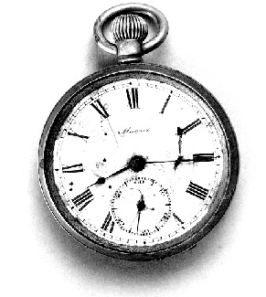
Introduction
Server Events

Slide 5

Introduction
Presentation
Normally when a browser visits a web page
An HTTP request is sent to the web server
The web server acknowledges this request and sends back the response
In many cases, the response could be stale by the time the browser renders the page…

Slide 6
Introduction
Presentation
To get the most up-to-date "real-time" information without refreshing manually, you can use:
Polling
Long-polling
Streaming
And since recently, WebSockets !

Slide 7
Introduction
Polling
Ajax client
Server
Update
request
response
request
response
Update
With polling, the browser sends HTTP requests at regular intervals and immediately receives a response

Slide 8
Introduction
Long-Polling
Ajax client
Server
request
response
Update
request
response
Update
With long-polling, the browser sends a request to the server and the server keeps the request open for a set period

Slide 9
Introduction
Streaming
Ajax client
Server
request
response
Update
response
Update
With streaming, the browser sends a complete request, but the server maintains an open response that is continuously updated

Slide 10
Introduction
Benefits & Drawbacks
 | Benefits | Drawbacks
Polling | Good solution if the exact interval of message delivery is known | Many connections are opened and closed needlessly
Long-polling | Receive message updates immediately after they are delivered | Hold requests increases server load
Streaming | No need to send several requests | Hold requests and increases server load and browsers need to close and reconnect the channel to release memory
A common drawback of the three solutions, is that they use the HTTP protocol

Slide 11


Questions ?

Slide 12
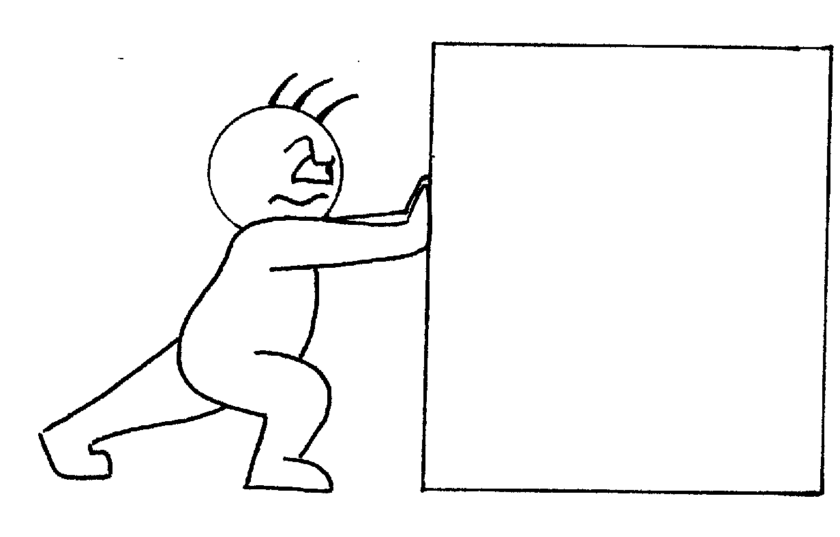
Server sent event
Server Events

Slide 13
Server Sent Event
Presentation
Server Sent Event (SSE) is a new specification for event streaming
Unidirectional channel
Use HTTP connection for receiving push notifications
Events in the form of DOM events

Slide 14
Server Sent Event
JavaScript API
SSE API provides the EventSource interface to open a connection to a stream
var source = new EventSource("/stream");
source.addEventListener("message", function(event) {
console.log(event.data);
});

Slide 15
Server Sent Event
JavaScript API
The constructor require an URL to a valid stream
Can be an absolute or relative URL
If absolute, its origin must match that of the calling page

Slide 16
Server Sent Event
JavaScript API
Once created, you can set up handlers for the following events :
open
messsage
error
source.addEventListener('message', function(e) { ... });
source.addEventListener('open', function(e) { ... });
source.addEventListener('error', function(e) { ... });

Slide 17
Server Sent Event
Event Stream Format
A SSE event stream must be :
A plaintext response
Served with a text/event-stream Content-Type
Each message must be
Prefixed by "data: "
Followed by two "\n" characters to end the sream
data: My message\n\n

Slide 18
Server Sent Event
Event Stream Format
You can send multiline message as follow :
Will produce "first line\nsecond line" in event.data
data: First line\n
data: Second line\n\n

Slide 19
Server Sent Event
Event Stream Format
You can also send JSON message as follow :
data: {\n
data: "msg": "hello world",\n
data: "id": 12345\n
data: }\n\n

Slide 20
Server Sent Event
Event ID
You can associate an event to a unique ID :
Lets the browser keep track of the last event fired
If the connection is dropped, a special HTTP header (Last-Event-ID) is set with the new request
id: 12345\n
data: Azerty\n\n

Slide 21
Server Sent Event
Event Name
You can associate an event to a name :
On the client, an event listener can be setup to listen to that particular event
event: userlogon\n
data: {"username": "John123"}\n\n
event: update\n
data: {"username": "John123", "emotion": "happy"}\n\n
source.addEventListener('userlogon', function(e) { ... });

Slide 22
Server Sent Event
SSE server
SSEs are sent over traditional HTTP
Do not require a special protocol or server implementation to get working !
You can easily implement server-side code to use it
Just render the event stream as described by the specification

Slide 23
Questions ?

Slide 24
Websocket
Server Events

Slide 25
WebSocket
Presentation
Web Sockets represents the next evolution of web communications
Bidirectional communications channel
Through a single socket over the Web
To establish a connection
HTTP protocol is upgraded to the WebSocket protocol

Slide 26
WebSocket
Working
Browser
Server
WebSocket Upgrade
Update
WebSocket Frame
Update
WebSocket Frame
Update
WebSocket Frame

Slide 27
WebSocket
Handshake
The WebSocket handshake:
GET /text HTTP/1.1\r\n
Upgrade: WebSocket\r\n
Connection: Upgrade\r\n
Host: www.websocket.org\r\n
...\r\n
request
HTTP/1.1 101 WebSocket Protocol Handshake\r\n
Upgrade: WebSocket\r\n
Connection: Upgrade\r\n
...\r\n
response
Notes:
The first

Slide 28
WebSocket
Network usage
Network throughput overhead of the polling:
Number of clients polling every second | Estimated network throughput
1000 | 6.6 Mbps
10 000 | 66 Mbps
100 000 | 665 Mbps

Slide 29
WebSocket
Network usage
Network throughput overhead of WebSocket:
Number of clients receiving 1 message/second | Estimated network throughput
1000 | 0.015 Mbps
10 000 | 0.153 Mbps
100 000 | 1.526 Mbps

Slide 30
WebSocket
WebSocket Interface - Constructor
The WebSocket interface propose the following constructor :
WebSocket(url, protocol)
url specifies the URL to which to connect
protocol specifies a sub-protocol that the server must support for the connection (optional)

Slide 31
WebSocket
WebSocket Interface - Attributes
The readyState interface attribute represents the state of the connection
Can have the following values :
CONNECTING (numeric value 0)
OPEN (numeric value 1)
CLOSED (numeric value 2)

Slide 32
WebSocket
WebSocket Interface - Method
The send(data) method allows you to transmit data using the connection
If the readyState attribute is CONNECTING,
An INVALID_STATE_ERR exception is raised

Slide 33
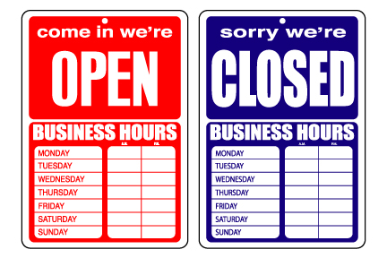
WebSocket
Event handlers
The interface provide four event handlers :
onopen
onmessage
onclose
onerror

Slide 34
WebSocket
Example
var WS_URL = "ws://www.host.com/socket"
, websocket = new WebSocket(WS_URL, "echo-protocol");
websocket.onopen = function(evt) {
websocket.send("Hello Socket!");
}
websocket.onmessage = function(evt) {
console.log("Socket says: " + evt.data);
}
websocket.onclose = function(evt) {
console.log("You are disconnected from the socket.");
}

Slide 35
WebSocket
WebSocket server
A lot of libraries are available to implement WebSocket servers
We’ll see how to develop a WebSocket server with Node.js in a next chapter…

Slide 36
Questions ?

Slide 37


